Slide 1
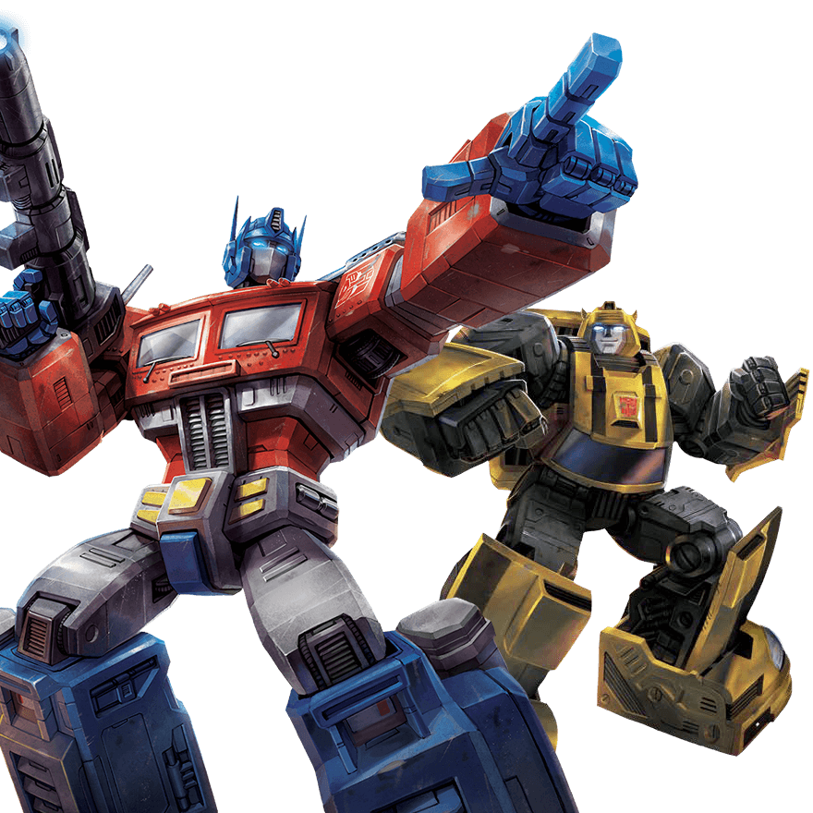
BERT
李宏毅
Hung-yi Lee
Notes:
https://lilianweng.github.io/lil-log/2019/01/31/generalized-language-models.html
Contextual Word Representations: Putting Words into Computers
BERT: 這篇不錯 主要是分析 BERT
https://zhuanlan.zhihu.com/p/58430637

Slide 2
1-of-N Encoding
Word Embedding
apple = [ 1 0 0 0 0]
dog
bag = [ 0 1 0 0 0]
rabbit
run
cat = [ 0 0 1 0 0]
jump
cat
dog = [ 0 0 0 1 0]
tree
flower
elephant = [ 0 0 0 0 1]
Word Class
class 1
Class 2
Class 3
dog
ran
flower
cat
jumped
bird
walk
tree
apple

Slide 3
A word can have multiple senses.
https://arxiv.org/abs/1902.06006
Have you paid that money to the bank yet ?
It is safest to deposit your money in the bank .
The victim was found lying dead on the river bank .
They stood on the river bank to fish.
The hospital has its own blood bank.
The third sense or not?
Notes:
Examples
The :

Slide 4
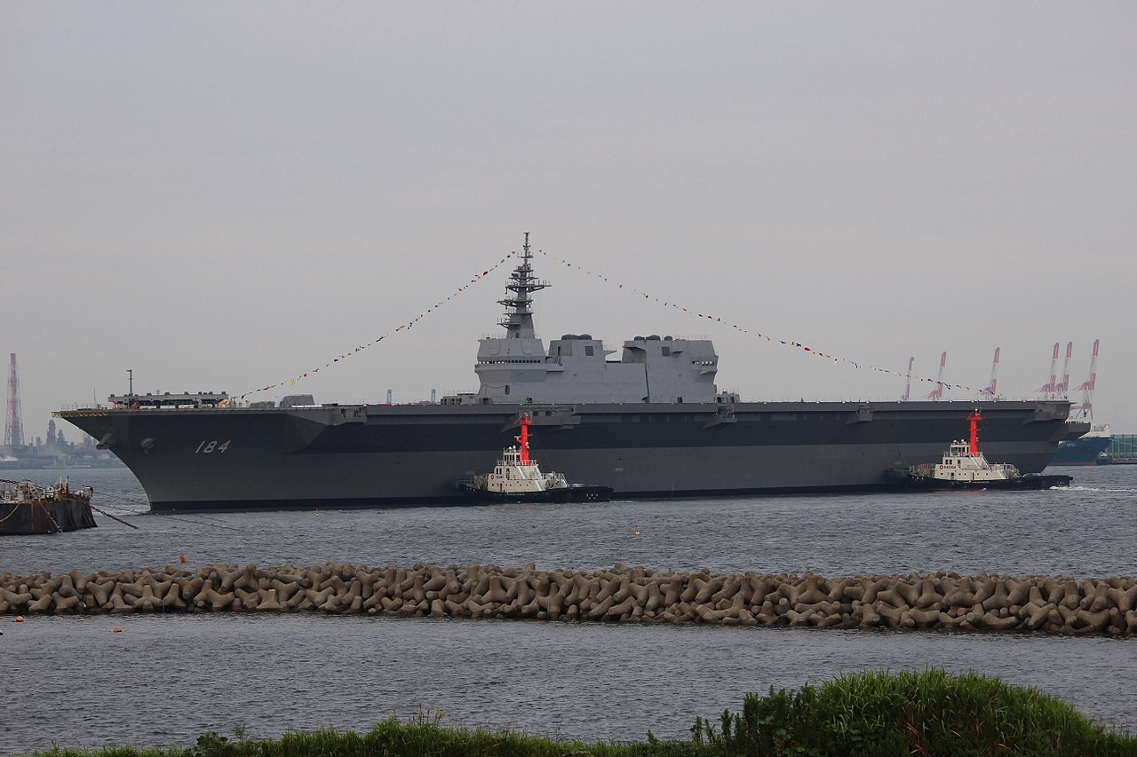
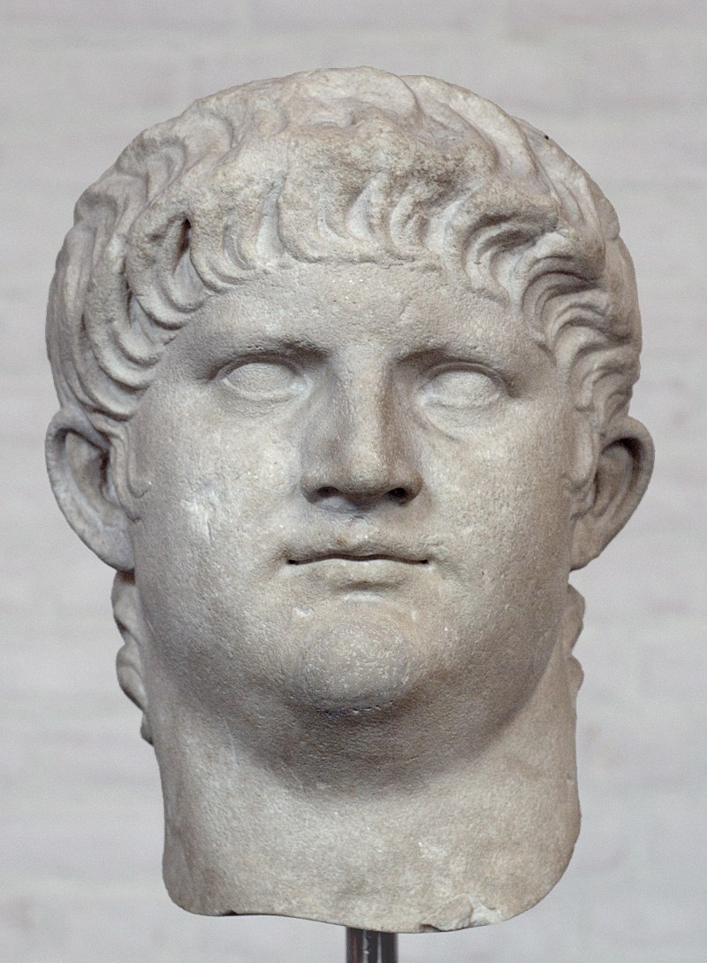
More Examples
這是
加賀號護衛艦
他是尼祿
這也是加賀號護衛艦
她也是尼祿

Slide 5
Contextualized Word Embedding
Contextualized Word Embedding
Contextualized
Word Embedding
…
the
river
bank
…
…
money
in
the
bank
…
Contextualized Word Embedding
…
own
blood
bank
…
Notes:
Examples

Slide 6
Embeddings from Language Model (ELMO)
https://arxiv.org/abs/1802.05365
RNN-based language models (trained from lots of sentences)
e.g. given “潮水 退了 就 知道 誰 沒穿 褲子”
潮水
退了
就
潮水
退了
就
RNN
RNN
RNN
…
…
RNN
RNN
RNN
…
RNN
RNN
RNN
…
…
RNN
RNN
RNN
…
<BOS>
潮水
退了
退了
就
知道

Slide 7
ELMO
Each layer in deep LSTM can generate a latent representation.
Which one should we use???
…
…
…
…
…
…
RNN
RNN
RNN
…
…
RNN
RNN
RNN
…
$$h_{2}$$
RNN
RNN
RNN
…
…
RNN
RNN
RNN
…
RNN
RNN
RNN
…
…
RNN
RNN
RNN
…
$$h_{1}$$
<BOS>
潮水
退了
退了
就
知道

Slide 8
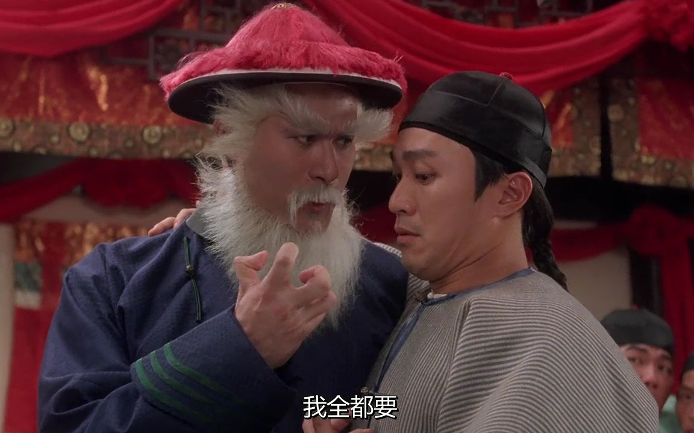

Slide 9
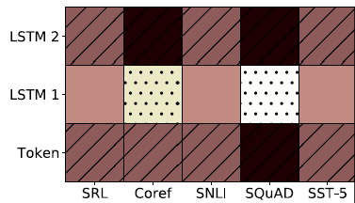
ELMO
=
$$α_{1}$$
+
$$α_{2}$$
Learned with the down stream tasks
ELMO
small
large
潮水
退了
就
知道
……

Slide 10
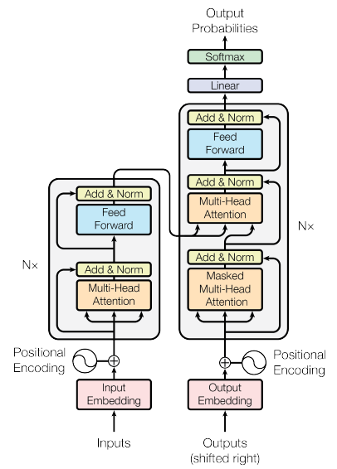
Bidirectional Encoder Representations from Transformers (BERT)
BERT = Encoder of Transformer
Learned from a large amount of text without annotation
Encoder
……
BERT
潮水
退了
就
知道
……

Slide 11
Training of BERT
vocabulary size
Predicting the masked word
Approach 1:
Masked LM
Linear Multi-class
Classifier
……
BERT
潮水
[MASK]
……
退了
就
知道
Notes:
Can we compare BERT and ELMO??

Slide 12
Training of BERT
Approach 2: Next Sentence Prediction
yes
[CLS]: the position that outputs classification results
Linear Binary
Classifier
[SEP]: the boundary of two sentences
Approaches 1 and 2 are used at the same time.
BERT
[CLS]
醒醒
吧
[SEP]
你
沒有
妹妹

Slide 13
Training of BERT
Approach 2: Next Sentence Prediction
No
[CLS]: the position that outputs classification results
Linear Binary
Classifier
[SEP]: the boundary of two sentences
Approaches 1 and 2 are used at the same time.
BERT
[CLS]
醒醒
吧
[SEP]
眼睛
業障
重

Slide 14
How to use BERT – Case 1
class
Linear Classifier
Trained from Scratch
Input: single sentence,
output: class
Example:
Sentiment analysis (our HW),
Document Classification
BERT
Fine-tune
[CLS]
w₁
w₂
w₃
sentence
Notes:
(https://arxiv.org/abs/1805.12471)

Slide 15
How to use BERT – Case 2
class
class
class
Linear Cls
Linear Cls
Linear Cls
Input: single sentence,
output: class of each word
Example: Slot filling
BERT
[CLS]
w₁
w₂
w₃
sentence
Notes:
(https://arxiv.org/abs/1805.12471)

Slide 16
How to use BERT – Case 3
Class
Input: two sentences, output: class
Example: Natural Language Inference
Linear Classifier
Given a “premise”, determining whether a “hypothesis” is T/F/ unknown.
BERT
[CLS]
w₁
w₂
[SEP]
w₃
w₄
w₅
Sentence 1
Sentence 2
Notes:
determining whether a “hypothesis” is true (entailment), false (contradiction), or undetermined (neutral) given a “premise”.

Slide 17
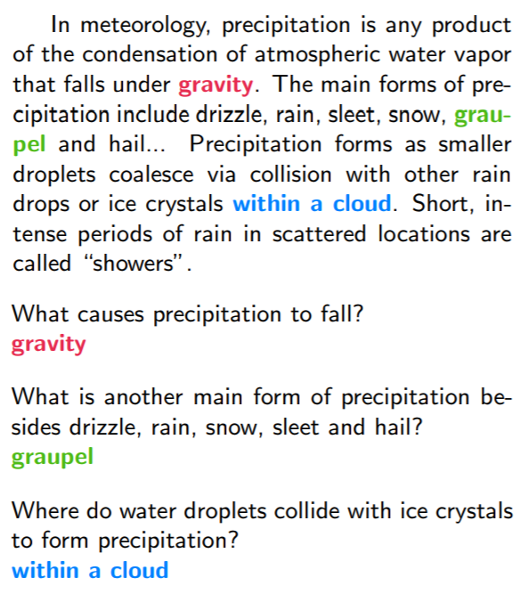
How to use BERT – Case 4
Extraction-based Question Answering (QA) (E.g. SQuAD)
17
Document:
$$D=\left\{d_{1},d_{2},⋯,d_{N}\right\}$$
Query:
$$Q=\left\{q_{1},q_{2},⋯,q_{N}\right\}$$
77
79
$$D$$
QA
Model
$$s$$
$$e$$
$$s=17,e=17$$
$$Q$$
output: two integers ($s$, $e$)
Answer:
$$A=\left\{q_{s}, ⋯,q_{e}\right\}$$
$$s=77,e=79$$

Slide 18
How to use BERT – Case 4
Learned from scratch
0.3
0.5
0.2
s = 2, e = 3
Softmax
The answer is “d₂ d₃”.
dot product
BERT
[CLS]
q₁
q₂
[SEP]
d₁
d₂
d₃
question
document
Notes:
determining whether a “hypothesis” is true (entailment), false (contradiction), or undetermined (neutral) given a “premise”.

Slide 19
How to use BERT – Case 4
Learned from scratch
0.1
0.2
0.7
s = 2, e = 3
Softmax
The answer is “d₂ d₃”.
dot product
BERT
[CLS]
q₁
q₂
[SEP]
d₁
d₂
d₃
question
document
Notes:
determining whether a “hypothesis” is true (entailment), false (contradiction), or undetermined (neutral) given a “premise”.

Slide 20
BERT 屠榜 ……
SQuAD 2.0
Notes:
屠榜

Slide 21
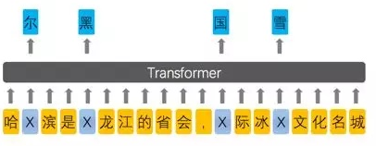
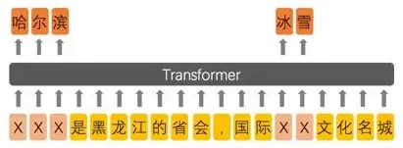
Enhanced Representation through Knowledge Integration (ERNIE)
Designed for Chinese
BERT
ERNIE
Source of image:
https://zhuanlan.zhihu.com/p/59436589
https://arxiv.org/abs/1904.09223
Notes:
From 擺渡https://zhuanlan.zhihu.com/p/59436589

Slide 22
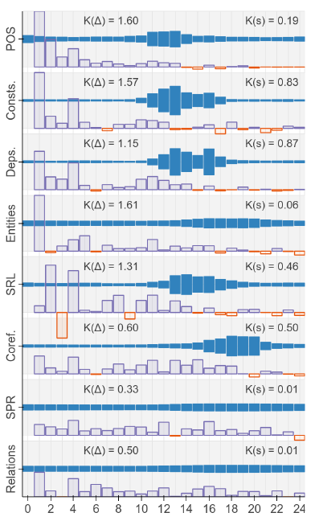
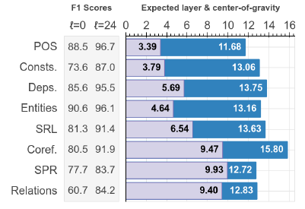
What does BERT learn?
https://arxiv.org/abs/1905.05950
https://openreview.net/pdf?id=SJzSgnRcKX
Notes:
BERT Rediscovers the Classical NLP Pipeline

Slide 23
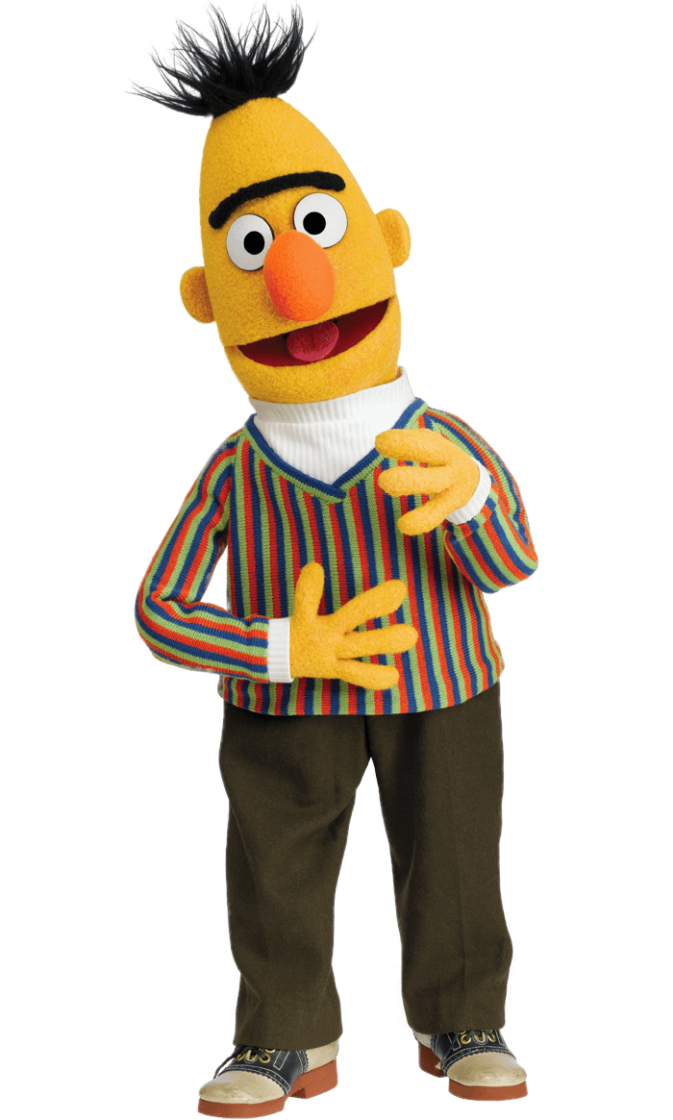
Multilingual BERT
https://arxiv.org/abs/1904.09077
Trained on 104 languages
Task specific training data for English
Task specific testing data for Chinese
En
Class 1
Zh
?
Zh
?
En
Class 2
Zh
?
En
Class 3
Zh
?
Zh
?
Notes:
Beto, Bentz, Becas: The Surprising Cross-Lingual Effectiveness of BERT

Slide 24
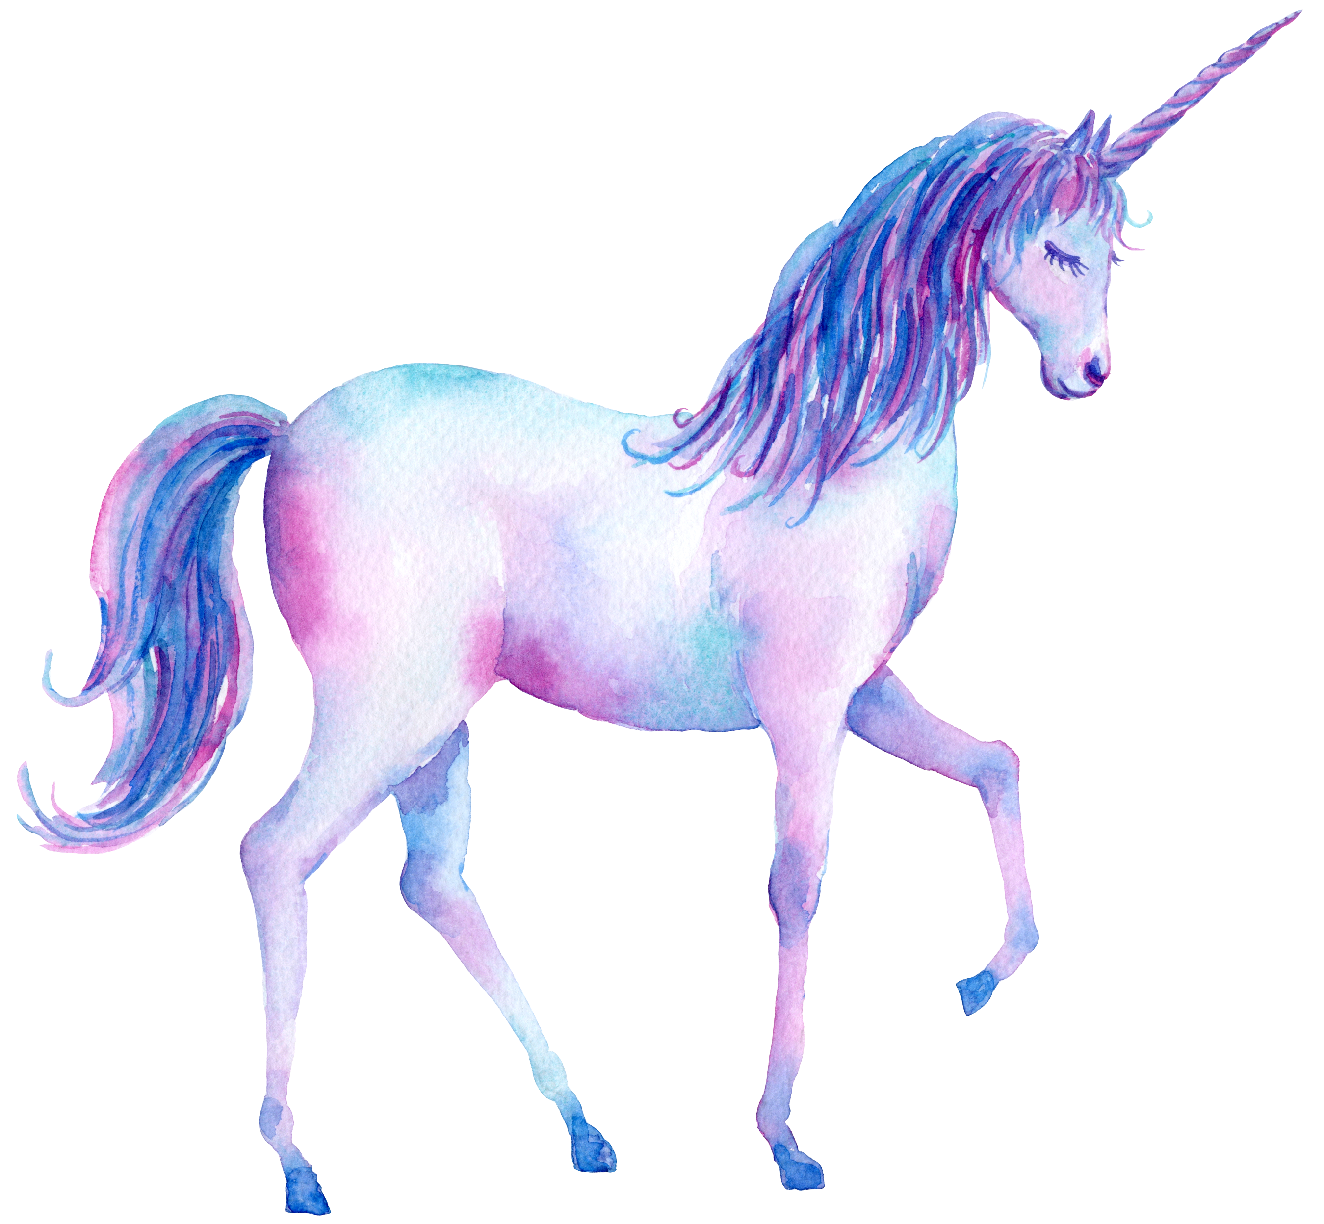
Generative Pre-Training (GPT)
https://d4mucfpksywv.cloudfront.net/better-language-models/language_models_are_unsupervised_multitask_learners.pdf
Transformer Decoder
BERT (340M)
ELMO (94M)
GPT-2 (1542M)
Source of image: https://huaban.com/pins/1714071707/
Notes:
93.6M
340M
1542M
40 GB

Slide 25
Generative Pre-Training (GPT)
退了
Many Layers …
$$b^{2}$$
$${\hat{α}}_{2,1}$$
$${\hat{α}}_{2,2}$$
$$q^{1}$$
$$k^{1}$$
$$v^{1}$$
$$q^{2}$$
$$k^{2}$$
$$v^{2}$$
$$q^{3}$$
$$k^{3}$$
$$v^{3}$$
$$q^{4}$$
$$k^{4}$$
$$v^{4}$$
$$a^{1}$$
$$a^{2}$$
$$a^{3}$$
$$a^{4}$$
<BOS>
潮水

Slide 26
Generative Pre-Training (GPT)
就
Many Layers …
$$b^{3}$$
$${\hat{α}}_{3,1}$$
$${\hat{α}}_{3,2}$$
$${\hat{α}}_{3,3}$$
$$q^{1}$$
$$k^{1}$$
$$v^{1}$$
$$q^{2}$$
$$k^{2}$$
$$v^{2}$$
$$q^{3}$$
$$k^{3}$$
$$v^{3}$$
$$q^{4}$$
$$k^{4}$$
$$v^{4}$$
$$a^{1}$$
$$a^{2}$$
$$a^{3}$$
$$a^{4}$$
<BOS>
潮水
退了
就

Slide 27
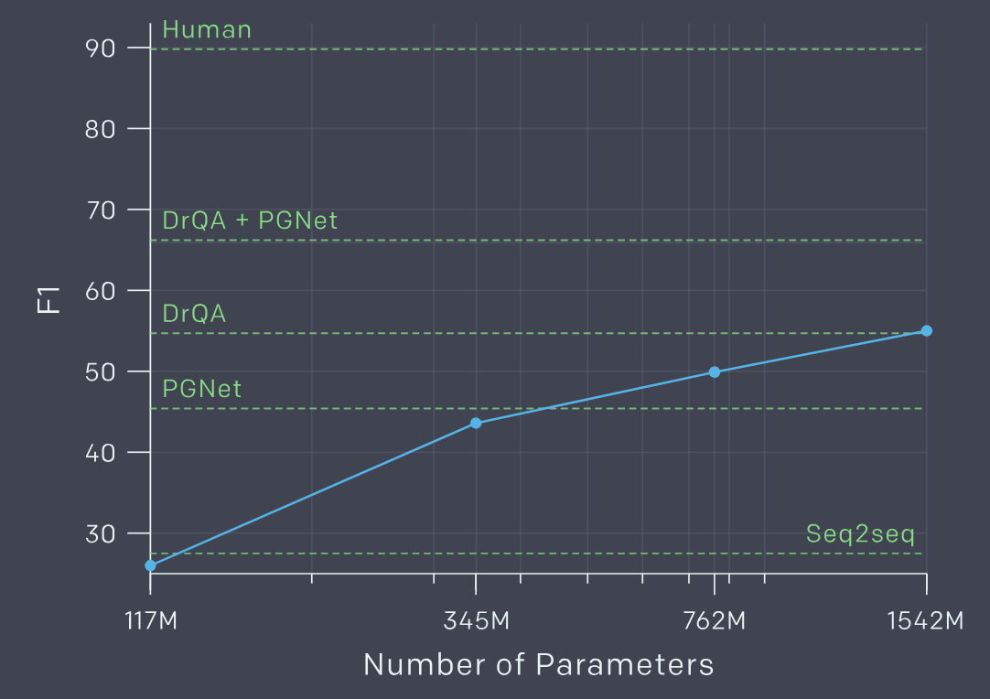
Zero-shot Learning?
Reading Comprehension
$d_{1},d_{2},⋯,d_{N}$,
”Q:”, $q_{1},q_{2},⋯,q_{N}$, “A:”
CoQA
Summarization
$d_{1},d_{2},⋯,d_{N}$,”TL;DR:”
Translation
English sentence 1
=
French sentence 1
English sentence 2
=
French sentence 2
English sentence 3
=
Notes:
展現神蹟

Slide 28
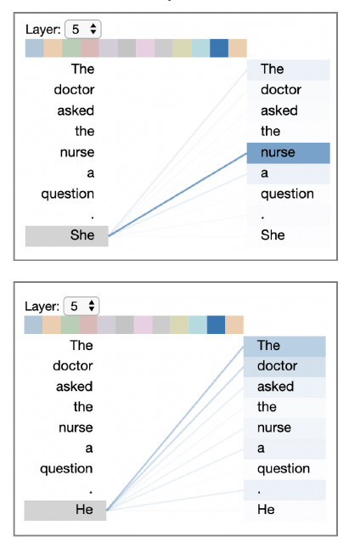
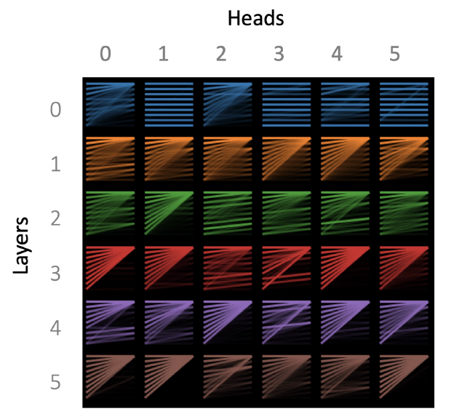
Visualization
https://arxiv.org/abs/1904.02679
(The results below are from GPT-2)

Slide 29
Notes:
There are more and more examples:
https://www.inside.com.tw/article/16479-open-ai-edit-the-avengers
https://towardsdatascience.com/openai-gpt-2-writes-alternate-endings-for-game-of-thrones-c9be75cd2425
https://hub.packtpub.com/openai-two-new-versions-and-the-output-dataset-of-gpt-2-out/
https://hackernoon.com/what-i-learned-using-gpt-2-to-write-a-novel-b74a6294c813

Slide 30
https://talktotransformer.com/

Slide 31
GPT-2
Credit: Greg Durrett

Slide 32
Can BERT speak?
Unified Language Model Pre-training for Natural Language Understanding and Generation
https://arxiv.org/abs/1905.03197
BERT has a Mouth, and It Must Speak: BERT as a Markov Random Field Language Model
https://arxiv.org/abs/1902.04094
Insertion Transformer: Flexible Sequence Generation via Insertion Operations
https://arxiv.org/abs/1902.03249
Insertion-based Decoding with automatically Inferred Generation Order
https://arxiv.org/abs/1902.01370

